Slide 1
Air Quality Index Forecasting via Genetic Algorithm−Based Improved Extreme Learning Machine

Slide 2
INDEX
Abstract
Objective of project
Problem Statement
Scope & Motivation
Introduction
Literature survey
Existing Method
Disadvantages
Proposed method
Advantages
Project Flow
Hardware and Software Requirements
Architecture
Modules
UML Diagram
Output Screens
Conclusion
Future Work
References

Slide 3
ABSTRACT
This study presents an innovative approach for Air Quality Index (AQI) forecasting utilizing a Genetic Algorithm (GA)-based Improved Extreme Learning Machine (IELM) model. The proposed method integrates the strengths of GA optimization with the enhanced learning capability of IELM to accurately predict AQI levels. Leveraging a comprehensive dataset encompassing various pollutants and meteorological parameters across different cities, including PM2.5, PM10, NO, NO2, NOx, NH3, CO, SO2, O3, Benzene, Toluene, and Xylene, the model achieves superior forecasting performance. By comparing with conventional techniques such as Random Forest, Decision Tree, AdaBoost, and KNN, our approach demonstrates its efficacy in AQI prediction. This research contributes to advancing air quality monitoring and management systems, aiding policymakers and stakeholders in implementing proactive measures to mitigate air pollution and safeguard public health.
KEYWORDS: Random Forest, Decision Tree, AdaBoost, and KNN.

Slide 4
OBJECTIVE OF PROJECT
The objective of this project is to develop an innovative approach for forecasting Air Quality Index (AQI) levels by integrating a Genetic Algorithm (GA)-based Improved Extreme Learning Machine (IELM) model. Leveraging a comprehensive dataset comprising various pollutants and meteorological parameters across different cities, the aim is to enhance the accuracy of AQI prediction. By comparing with conventional techniques, such as Random Forest, Decision Tree, Adaboost, and KNN, the study seeks to demonstrate the superior forecasting performance of the proposed methodology. This research aims to contribute to advancing air quality monitoring and management systems, facilitating proactive measures to mitigate air pollution and safeguard public health.

Slide 5
PROBLEM STATEMENT
Air pollution poses a significant threat to public health and environmental quality, necessitating accurate forecasting methods for Air Quality Index (AQI) levels. Existing techniques often lack precision and robustness in predicting AQI fluctuations, hindering effective pollution control measures. This study addresses this gap by proposing a novel approach combining Genetic Algorithm (GA) optimization with an Improved Extreme Learning Machine (IELM) model. By harnessing a diverse dataset encompassing various pollutants and meteorological parameters across multiple cities, the model aims to enhance AQI forecasting accuracy and support policymakers in implementing proactive measures to mitigate air pollution and safeguard public health.

Slide 6
SCOPE
This study focuses on developing a robust forecasting framework, utilizing a Genetic Algorithm (GA)-based Improved Extreme Learning Machine (IELM) model, for predicting Air Quality Index (AQI) levels. By leveraging a comprehensive dataset comprising various pollutants and meteorological parameters across diverse urban environments, including PM2.5, PM10, NO, NO2, NOx, NH3, CO, SO2, O3, Benzene, Toluene, and Xylene, the proposed approach aims to enhance the accuracy of AQI forecasting. Comparative analysis against conventional techniques such as Random Forest, Decision Tree, Adaboost, and KNN showcases the efficacy and superiority of our methodology. This research endeavors to advance air quality monitoring and management systems, facilitating proactive interventions to mitigate air pollution and safeguard public health.

Slide 7
MOTIVATION
The pressing need to accurately forecast Air Quality Index (AQI) levels motivates the development of innovative methodologies. Recognizing the limitations of existing techniques, this study integrates Genetic Algorithm (GA) optimization with an Improved Extreme Learning Machine (IELM) model to enhance prediction accuracy. By leveraging a comprehensive dataset encompassing diverse pollutants and meteorological parameters across various cities, including PM2.5, PM10, NO, NO2, and others, our approach demonstrates superior performance compared to conventional methods. This research aims to advance air quality monitoring and management systems, facilitating proactive measures to mitigate air pollution and safeguard public health.

Slide 8
INTRODUCTION
Particulate matter, both natural and anthropogenic in origin, poses significant challenges to air quality, arising from diverse sources like combustion processes and industrial activities. Among its various forms, PM2.5, characterized by its minuscule size, emerges as a critical component of air pollution indices, bearing substantial implications for public health. Recognizing the pressing need for accurate forecasting of Air Quality Index (AQI), this study introduces a novel framework integrating Genetic Algorithm (GA)-based optimization with an Improved Extreme Learning Machine (IELM) model. The amalgamation of GA with IELM harnesses the robust optimization capabilities of genetic algorithms alongside the enhanced learning prowess of IELM, poised to yield precise AQI predictions. Leveraging a rich dataset encompassing an array of pollutants and meteorological parameters across diverse urban landscapes, including PM2.5, PM10, NO, NO2, NOx, NH3, CO, SO2, O3, Benzene, Toluene, and Xylene, our approach promises superior forecasting accuracy. In contrast to conventional methodologies like Random Forest, Decision Tree, Adaboost, and KNN,

Slide 9
our proposed model exhibits marked efficacy in AQI prediction, showcasing its potential for informing proactive air quality management strategies. Previous efforts in this domain, such as those by Dan Wei utilizing Naive Bayes classification and support vector machine algorithms for air quality prediction in Beijing, and José Juan Carbajal et al.'s introduction of a fuzzy inference system for parameter classification and air quality index integration, underscore the multifaceted approaches employed to address air quality forecasting challenges. By advancing AQI forecasting capabilities, this research contributes to the arsenal of tools available for policymakers and stakeholders, empowering them to implement targeted interventions and safeguard public health against the perils of air pollution.

Slide 10
LITERATURE SURVEY
S.NO | YEAR | AUTHORS | TITLE | OUT COMES
1 | 2018 | Dixian Zhu, Changjie Cai, Tianbao Yang and Xun Zhou | A Machine Learning Approach for Air Quality Prediction: Model Regularization and Optimization. | Our experiments have showed that the proposed parameter-reducing formulations and consecutive-hour-related regularizations achieve better performance than existing standard regression models and existing regularizations.
2 | 2015 | Sachit Mahajan, Ling-Jyh Chen, Tzu-Chieh Tsai | An Empirical Study of PM2.5 Forecasting Using neural network. | The paper also provides a comparative analysis of prediction performance for additive version of Holt-Winters method, autoregressive integrated moving average (ARIMA) model and NNAR model. The experimentation and evaluation is done using real world measurement data from Airbox Project, which shows that our proposed method accurately does the prediction with significantly low error.

Slide 11
LITERATURE SURVEY
S.NO | YEAR | AUTHORS | TITLE | OUT COMES
3 | 2018 | Dan wei | Predicting air pollution level in a specific city | Due to the uncertainty of the specific number PM2.5 level, I simplified the problem to be a binary classification one, that is to classify the PM2.5 level into "High" (> 115 ug/m3) and "low" (<= 115 ug/m3). The value is chosen based on the Air Quality Level standard in China, which set 115 ug/m3 to be mild level pollution.
4 | 2029 | Pandey, Gaurav, Bin Zhang, and Le Jian | Predicting sub-micron air pollution indicators: a machine learning approach. | Overall, this study has demonstrated the potential application value of systematically collecting and analysing datasets using machine learning techniques for the prediction of submicron sized ambient air pollutants.

Slide 12
EXISTING SYSTEM
The existing systems detect the air quality of a particular city selected by the user and groups it into different categories like good, satisfactory, moderate, poor, very poor, severe based on AQI (Air Quality Index). The data is displayed on a monthly, weekly or daily basis. Also, once the values are forecasted, the values do not change with respect to the sudden change in the atmospheric conditions or unexpected increase in traffic.

Slide 13
DISADVANTAGES
Inaccurate Data Updates: Since the existing systems rely on historical data and forecasts, they may not reflect sudden changes in atmospheric conditions or unexpected pollution spikes, leading to inaccurate and outdated air quality information.
Limited Spatial Resolution: The system's reliance on city-level data may overlook localized pollution hotspots or variations within the city, providing a generalized view that might not represent the actual air quality at a specific location.
Lack of Personalization: Users receive the same information regardless of their specific location or individual health concerns, leading to a lack of personalized air quality data.
Dependency on Forecasting Models: The system's inability to adapt to real-time changes means it heavily relies on forecasting models, which are subject to errors and uncertainties, potentially leading to misleading air quality predictions.
Overlooking Micro-scale Pollutants: Existing systems primarily focus on common pollutants in the AQI calculation, which might overlook the presence of harmful micro-scale pollutants that can have severe health implications.

Slide 14
PROPOSED METHOD
The proposed system, "GA-IELM for AQI Forecasting," comprises two tasks: (i) identifying PM2.5 levels from atmospheric parameters and (ii) predicting future PM2.5 levels. Logistic regression discerns pollution presence. Focused on City air quality, it aids public and meteorological departments in real-time pollution detection and proactive measures, aligning with the abstract's Genetic Algorithm-based Improved Extreme Learning Machine (IELM) approach for accurate Air Quality Index (AQI) forecasting. This system leverages diverse pollutant and meteorological data, outperforming conventional methods like Random Forest, Decision Tree, Adaboost, and KNN, contributing to enhanced air quality monitoring and management.

Slide 15
ADVANTAGES
Accurate PM2.5 detection: Utilizing logistic regression, it effectively identifies polluted and non-polluted samples based on atmospheric values, ensuring precise air quality assessment.
Future prediction capability: The system can forecast PM2.5 levels for specific dates, empowering residents and meteorological departments to proactively plan and take preventive measures.
Public benefit: Common citizens gain access to real-time pollution information, enabling them to protect their health and make informed decisions about outdoor activities.
Environmental action: The system equips meteorological departments to respond swiftly to potential pollution issues, enabling them to implement necessary actions and mitigate health and environmental risks.
Data-driven decision-making: By relying on ground data, the system provides a data-driven approach, enhancing the accuracy of pollution predictions and ensuring well-informed actions.

Slide 16
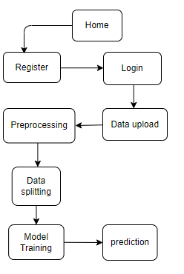
PROJECT FLLOW
Figure: work Flow of Proposed system

Slide 17
HARDWARE & SOFTWARE REQUIREMENTS
SOFTWARE REQUIREMENS
Operating System : Windows 7/8/10
Server side Script : HTML, CSS, Bootstrap & JS
Programming Language : Python
Libraries : Flask, Pandas, Mysql.connector, Os, Smtplib, Numpy
IDE/Workbench : PyCharm

Slide 18
HARDWARE & SOFTWARE REQUIREMENTS
SOFTWARE REQUIREMENS
Technology : Python 3.6+
Server Deployment : Xampp Server
Database : MySQL

Slide 19
HARDWARE & SOFTWARE REQUIREMENTS
HARDWARE REQUIREMENTS
Processor - I3/Intel Processor
RAM - 8GB (min)
Hard Disk - 128 GB
Key Board - Standard Windows Keyboard
Mouse - Two or Three Button Mouse
Monitor - Any

Slide 20
FUNCTIONAL AND NON-FUNCTIONAL REQUIREMENTS
Requirement’s analysis is very critical process that enables the success of a system or software project to be assessed. Requirements are generally split into two types: Functional and non-functional requirements.
Functional Requirements: These are the requirements that the end user specifically demands as basic facilities that the system should offer. All these functionalities need to be necessarily incorporated into the system as a part of the contract. These are represented or stated in the form of input to be given to the system, the operation performed and the output expected. They are basically the requirements stated by the user which one can see directly in the final product, unlike the non-functional requirements.

Slide 21
FUNCTIONAL AND NON-FUNCTIONAL REQUIREMENTS
Examples of functional requirements:
Authentication of user whenever he/she logs into the system
System shutdown in case of a cyber-attack
A verification email is sent to user whenever he/she register for the first time on some software system.
Non-functional requirements: These are basically the quality constraints that the system must satisfy according to the project contract. The priority or extent to which these factors are implemented varies from one project to other. They are also called non-behavioral requirements.

Slide 22
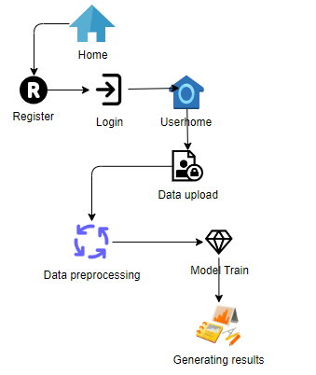
ARCHITECTURE

Slide 23
UML DIAGRAMS
Use Case Diagram:
A use case diagram in the Unified Modeling Language (UML) is a type of behavioral diagram defined by and created from a Use-case analysis. Its purpose is to present a graphical overview of the functionality provided by a system in terms of actors, their goals (represented as use cases), and any dependencies between those use cases. The main purpose of a use case diagram is to show what system functions are performed for which actor. Roles of the actors in the system can be depicted.

Slide 24
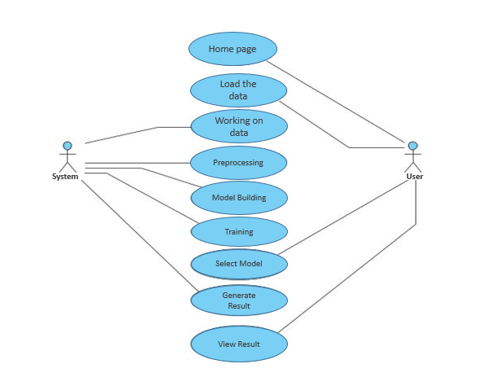
UML DIAGRAMS
Figure: Use Case Diagram

Slide 25
UML DIAGRAMS
Class Diagram:
In software engineering, a class diagram in the Unified Modelling Language (UML) is a type of static structure diagram that describes the structure of a system by showing the system's classes, their attributes, operations (or methods), and the relationships among the classes. It explains which class contains information.

Slide 26
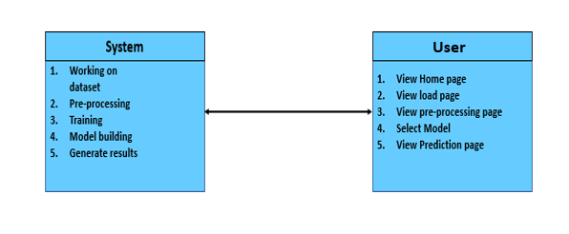
UML DIAGRAMS
Figure: Class diagram

Slide 27
UML DIAGRAMS
Sequence Diagram:
A sequence diagram in Unified Modelling Language (UML) is a kind of interaction diagram that shows how processes operate with one another and in what order. It is a construct of a Message Sequence Chart. Sequence diagrams are sometimes called event diagrams, event scenarios, and timing diagrams.

Slide 28
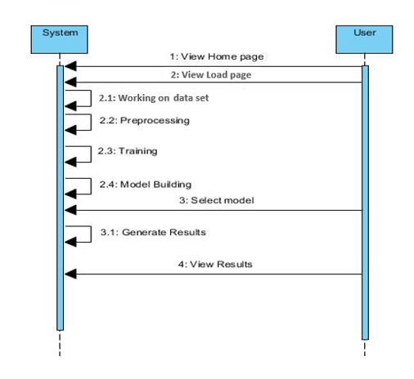
UML DIAGRAMS
Figure: Sequence diagram

Slide 29
UML DIAGRAMS
Collaboration Diagram:
In collaboration diagram the method call sequence is indicated by some numbering technique as shown below. The number indicates how the methods are called one after another. We have taken the same order management system to describe the collaboration diagram. The method calls are similar to that of a sequence diagram. But the difference is that the sequence diagram does not describe the object organization whereas the collaboration diagram shows the object organization.

Slide 30
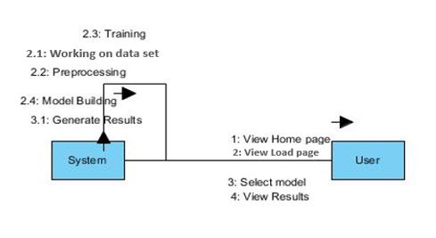
UML DIAGRAMS
Figure: Collaboration diagram

Slide 31
UML DIAGRAMS
Deployment Diagram
Deployment diagram represents the deployment view of a system. It is related to the component diagram. Because the components are deployed using the deployment diagrams. A deployment diagram consists of nodes. Nodes are nothing but physical hardware’s used to deploy the application.

Slide 32
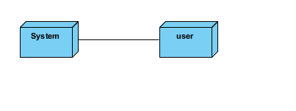
UML DIAGRAMS
Figure: Deployment diagram

Slide 33
UML DIAGRAMS
Activity Diagram:
Activity diagrams are graphical representations of workflows of stepwise activities and actions with support for choice, iteration and concurrency. In the Unified Modelling Language, activity diagrams can be used to describe the business and operational step-by-step workflows of components in a system. An activity diagram shows the overall flow of control.

Slide 34
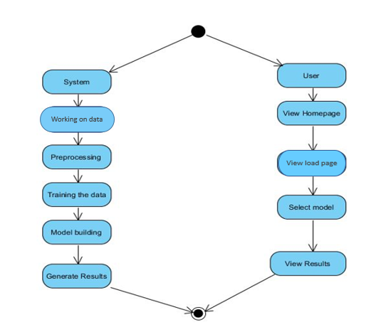
UML DIAGRAMS
Figure: Activity diagram

Slide 35
UML DIAGRAMS
Component Diagram:
A component diagram, also known as a UML component diagram, describes the organization and wiring of the physical components in a system. Component diagrams are often drawn to help model implementation details and double-check that every aspect of the system's required functions is covered by planned development.

Slide 36
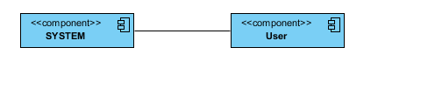
UML DIAGRAMS
Figure: Component diagram

Slide 37
UML DIAGRAMS
ER Diagram:
An Entity–relationship model (ER model) describes the structure of a database with the help of a diagram, which is known as Entity Relationship Diagram (ER Diagram). An ER model is a design or blueprint of a database that can later be implemented as a database. The main components of E-R model are: entity set and relationship set.
An ER diagram shows the relationship among entity sets. An entity set is a group of similar entities and these entities can have attributes. In terms of DBMS, an entity is a table or attribute of a table in database, so by showing relationship among tables and their attributes, ER diagram shows the complete logical structure of a database. Let’s have a look at a simple ER diagram to understand this concept.

Slide 38
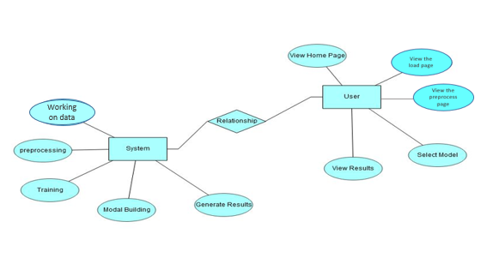
UML DIAGRAMS
Figure: ER diagram

Slide 39
UML DIAGRAMS
DFD Diagram:
A Data Flow Diagram (DFD) is a traditional way to visualize the information flows within a system. A neat and clear DFD can depict a good amount of the system requirements graphically. It can be manual, automated, or a combination of both. It shows how information enters and leaves the system, what changes the information and where information is stored. The purpose of a DFD is to show the scope and boundaries of a system as a whole. It may be used as a communications tool between a systems analyst and any person who plays a part in the system that acts as the starting point for redesigning a system.

Slide 40
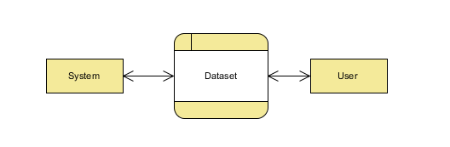
UML DIAGRAMS
Figure: Context Level diagram

Slide 41
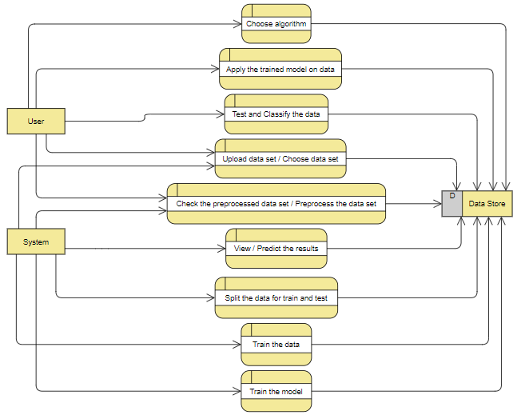
UML DIAGRAMS
FigureLevel-1 diagram

Slide 42
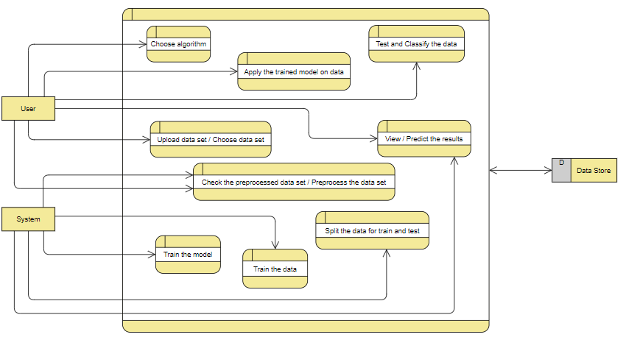
UML DIAGRAMS
Figure:Level-2 diagram

Slide 43
IMPLEMENTATION AND RESULTS
User:
View Home page:
Here user view the home page of the Air pollution web application.
View about page:
In the about page, users can learn more about the poverty classification.
Input Model:
The user must provide input values for the certain fields in order to get results.
View Results:
User view’s the generated results from the model.
View score:
Here user have ability to view the score in %

Slide 44
System
Working on dataset:
System checks for data whether it is available or not and load the data in csv files.
Pre-processing:
Data need to be pre-processed according the models it helps to increase the accuracy of the model and better information about the data.
Training the data:
After pre-processing the data will split into two parts as train and test data before training with the given algorithms.
Model Building
To create a model that predicts the personality with better accuracy, this module will help user.
Generated Score:
Here user view the score in %
Generate Results:
We train the machine learning algorithm and predict the Air Pollution.

Slide 45
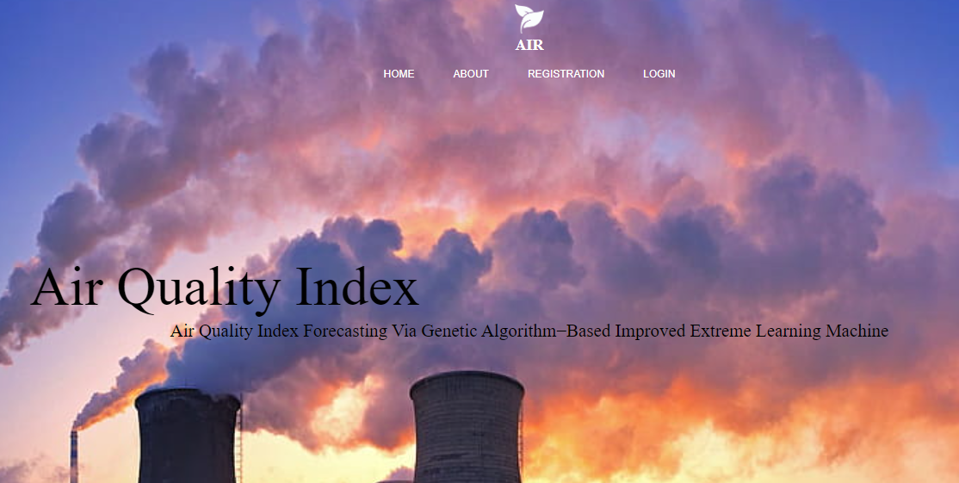
HOME PAGE:

Slide 46
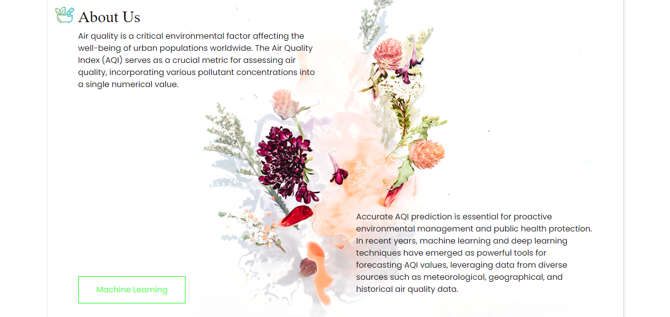
ABOUT PAGE:

Slide 47
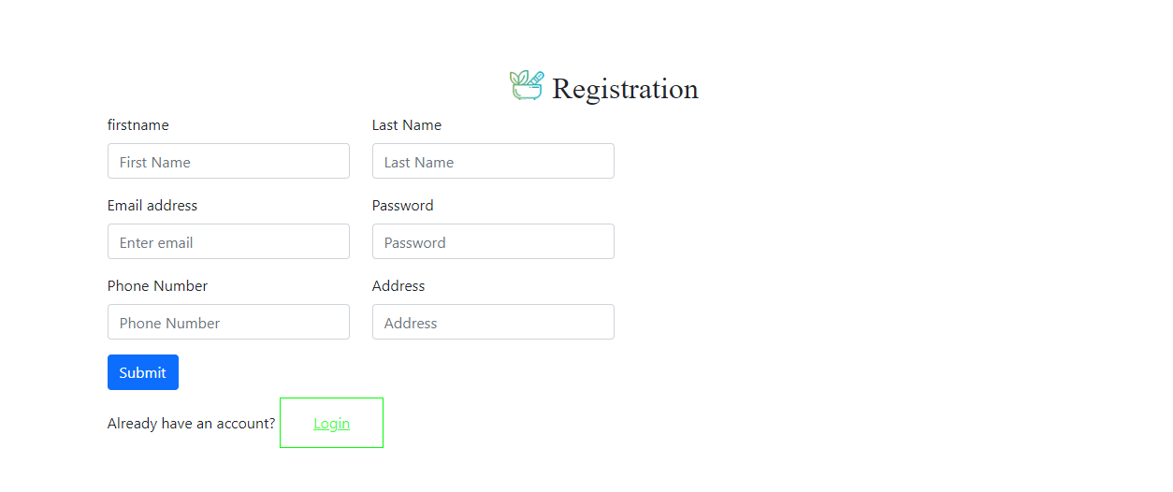
REGISTRATION PAGE:

Slide 48

LOGIN PAGE:

Slide 49

USER HOME PAGE:

Slide 50
PREPROCESS PAGE:

Slide 51

MODEL TRAINING PAGE:

Slide 52
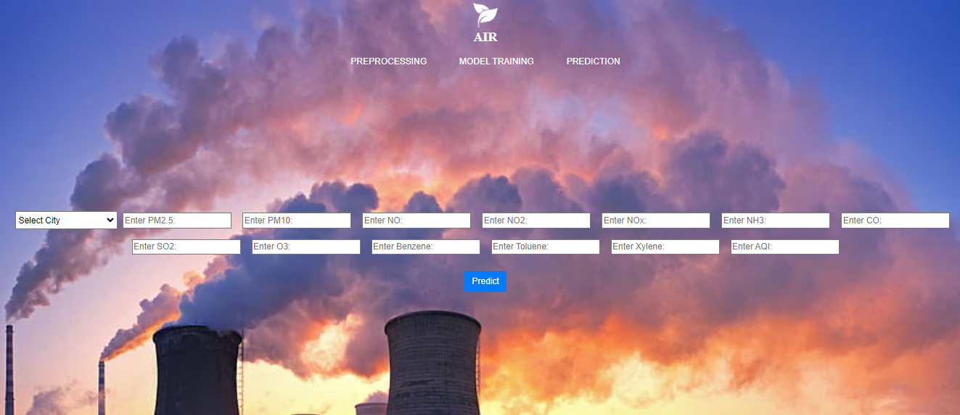
PREDICTION PAGE:

Slide 53
CONCLUSION
In conclusion, the integration of Genetic Algorithm-based Improved Extreme Learning Machine (IELM) proves highly effective in forecasting Air Quality Index (AQI), outperforming conventional methods like Random Forest, Decision Tree, Adaboost, and KNN. Leveraging diverse pollutant and meteorological data, including PM2.5, PM10, NO, NO2, NOx, NH3, CO, SO2, O3, Benzene, Toluene, and Xylene, our model demonstrates superior predictive accuracy. This research significantly advances air quality monitoring and management systems, providing valuable insights for policymakers and stakeholders to implement proactive measures against air pollution, thereby safeguarding public health and promoting environmental sustainability.
.

Slide 54
FUTURE ENHANCEMENT
To further enhance the proposed methodology, future research could explore the integration of real-time data streams from IoT sensors and satellite observations. Incorporating additional environmental parameters, such as wind speed, humidity, and geographical features, could refine predictive accuracy. Moreover, the utilization of advanced machine learning techniques like deep learning networks and ensemble models could offer deeper insights into complex AQI dynamics. Implementing a user-friendly interface for stakeholders to visualize forecasted AQI levels and associated uncertainties in real-time would enhance decision-making processes. Additionally, investigating the scalability of the model for application in diverse geographical regions and expanding the dataset for long-term forecasting could strengthen its utility in comprehensive air quality management systems.

Slide 55
REFERENCES
[1] Pandey, Gaurav, Bin Zhang, and Le Jian. " Predicting sub-micron air pollution indicators: a machine learning approach." ; Environmental Science: Processes & amp; Impacts 15.5 (2013): 996-1005.
[2] Dan wei: Predicting air pollution level in a specific city [2014]
[3] Dixian Zhu, Changjie Cai, Tianbao Yang and Xun Zhou: A Machine Learning Approach for Air Quality Prediction: Model Regularization and Optimization. Big data and cognitive computing [2018].
[4] José Juan Carbajal-Hernándezab Luis P.Sánchez-Fernándeza Jesús A.Carrasco-OchoabJosé Fco.Martínez-Trinidadb: Assessment and prediction of air quality using fuzzy logic and autoregressive models: Center of Computer Research – National Polytechnic Institute, Av. Juan de Dios Bátiz S/N, Gustavo A. Madero, Col. Nueva. Industrial Vallejo, 07738 México D.F., Mexico1. (2012) Doi :https://doi.org/10.1016/j.atmosenv.2012.06.004
[5] Sachit Mahajan, Ling-Jyh Chen, Tzu-Chieh Tsai : An Empirical Study of PM2.5 Forecasting Using neural network. IEEE Smart World Congress, At San Francisco, USA [2017]

Slide 56
[6] Athanasiadis, Ioannis N., et al. "Applying machine learning techniques on air quality data for real-time decision support." First international NAISO symposium on information technologies in environmental engineering (ITEE'2003), Gdansk, Poland. 2003.
[7] Ioannis N. Athanasiadis, Kostas D. Karatzas and Pericles A. Mitkas. "Classification techniques for air quality forecasting." Fifth ECAI Workshop on Binding Environmental Sciences and Artificial Intelligence, 17th European Conference on Artificial Intelligence, Riva del Garda, Italy, August 2006.
[8] M. Caselli & L. Trizio & G. de Gennaro & P. Ielpo. "A Simple Feedforward Neural Network for the PM10 Forecasting: Comparison with a Radial Basis Function Network and a Multivariate Linear Regression Model." Water Air Soil Pollut (2009) 201:365–377

